Slide 1

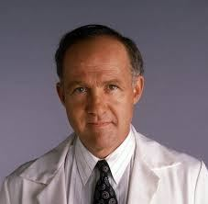

Software Engineering
A Practitioner’s Approach
The Book by: Roger S. Pressman
I made those slides retyping highlights of the most important parts.
I wrote it as I would retell it to anyone.
Slides by: Zack Enixey

Slide 2

Part 2 - Chapter 4
Principles That Guide Practice

Slide 3




Principles that guide PROCESS:
Be agile: the basic tenets of agile development should govern your approach,
Focus on QUALITY on every step,
Be ready to adopt, no place for dogma, be open for change,
Build an effective team, the people is what matters,
Establish mechanisms for communication and coordination, (the project will fail cause important information fails into cracks). Talk with team,
Manage change, (mechanisms must be established to manage the way changes are requested, assessed, approved and implemented,
Assess risk. Be aware: “lots of things can go wrong”! Make a list of possible risks.
Create work products that provide value for others! Do not waste you time if no one needs it, and no one wants to buy it.

Slide 4

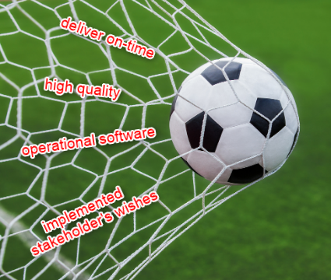
Break into pieces and than solve it
What is software engineering ‘practice’? Practice is a collection of concepts, principles, methods, and tools. Software practice transforms a haphazard unfocused approach
into something more organized.
Principles that guide PRACTICE:
Divide and conquer. Large problem is easier to solve if it is subdivided into a collection of elements,
Use abstraction: it is simplification of some complex element. Use one word to explain whole system. Use abbreviations. Eliminate details,
GOALS OF SOFTWARE ENGINEERING
Be consistent. Stick to the goal. Don’t wiggle,
Focus on The transfer of information: from a DB to the user,
Build software that exhibits effective MODULARITY,
Use PATTERNS: Singleton, Factory… don’t reinvent a wheel.
Look for as much as different perspectives.
Remember that someone will maintain the software. (write the code like the user is a psychopath who knows where you live)

Slide 5



Communication Principles:
Listen: Focus on the speaker’s words, don’t interrupt him/her,
Prepare before you communicate: understand the problem before a meeting,
Someone needs to facilitate the activity (facilitator),
Face-to-Face communication is the best,
Take notes (we need someone to write everything down)
Strive for collaboration, we all describe product and wanted functionality,
Don’t waste time. You agree on something, move on, you can’t agree, move on, feature is unclear to everyone, move on. Moving on is the best way to achieve communication agility.
Make it Win-Win communication.

Slide 6
Planning Principles:
‘Quick pan game’ is necessary, but the ROAD MAP
will emerge along with the real work
Understand the scope of the project. Know the destination where you are going,
Always include stakeholders in planning activity,
Planning should be iterative, (things will be changing all the time)
Planning should be conducted enough to provide useful guidance for the team, no more, no less.
Consider risk and point to risky areas, have plan B,
Be realistic, people don’t work 100% all the time, changes will happen, problems will happen, so keep it real.
Don’t go into detail, have ‘low-granularity’ plan it will give you broader work tasks for longer time periods.

Slide 7

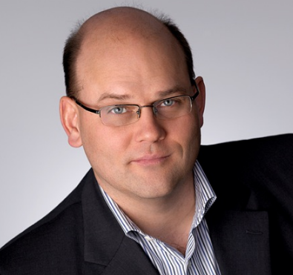
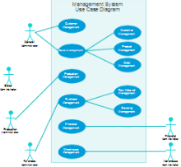
Modeling Principles:
One of the founders
of Extreme
Programming
Were defined by:
Use models as travel light,
KISS – keep it strictly simple,
Stick to the gist, ‘What is the topic?’, ‘What’s the goal?’
The goal of modeling is to BUILD SOFTWARE, not to create models,
Functions and behavior of the software must be defined (I would use User stories for this),
Makes modes that are easy to change in future. So… don’t go into details,
Every part of the model has to have purpose, model has to be USEFUL,
Get feedback as soon as you can and update model,
Design of data is as important as design of processing functions.
Requirements models (analysis models) represent customer requirements. Design model – represents characteristics of the software that help practitioners to construct Software effectively
Ron Jeffries
Scott Amber
UML
The software design model is analogous to an architect’s plan for a house.

Slide 8
Construction Principles:
Coding Principles:
Preparation principles: Before you write one line of code be sure you:
Understand the problem you’re trying to solve, and understand basic design principles and concepts.
Programming principles: As you begin writing code, be sure you:
Constrain your algorithms, optimize them,
Use pair programming,
Select data structures that will meet the needs of the design,
Keep logic as simple as possible, KISS
Make nested loops in the way to be easily testable
Write self-documenting code,
Validation principles:
Perform unit tests,
Refactor the code,
Testing Principles:
Testing is a process of executing a program with the intent of finding an error.
Testing should prove that software functions according to specification.

Slide 9
Deployment Principles:
Deployment encompasses three actions: delivery, support, feedback. Deployment happens not once, but a number of times as software moves toward completion. Each feedback provides the software team with important information for correction and improvement.
Customer often expects more than the team has promised to deliver (tell customer what to expect)
Prepare instructions to the end users, and make it easy to install and run.

Slide 10
Part 2 - Chapter 5
Understanding Requirements

Slide 11
Requirement engineering
Requirement engineering establishes a solid base for design and construction. We need it for Requirement gathering, requirements modeling, requirements management, and requirement validation. It provides mechanism for understanding what customer wants. I encompasses 7 distinct tasks:
Inception (start): the beginning, trying to identify breadth and depth of the market, doing analysis, identify stakeholders.
Elicitation: problems of scope must be removed. Possible problems: problems of scope: too much details that are confusing, problems of understanding: not knowing what exactly is expected, problems of changing opinions. Do elicitation in every iteration: Write and post a list of all ideas; Have a meeting; Discuss ideas; Add new ideas.

Slide 12
Requirement engineering
Elaboration: the information obtained from the customer during inception and elicitation is expanded and refined during elaboration.
Negotiation: stakeholders are asked to rank requirements and then discuss conflicts in priority. Explore conflicts from different point of views. Understand the problem. Ask questions to get more information. Ask them how they would solve the problem.
Specification: it can be a written document a set of graphical models, a formal mathematical model, a collection of usage scenarios, a prototype…
Validation: just to confirm there is NO ambiguity.
Requirements management: it’s a set of activities that help the project team identify, control and track requirements and changes as the project proceeds

Slide 13

What do we gather with Requirements gathering?
A statement of need and feasibility
Bounded statement of scope for the system product
A list of customers, users, and other stakeholders who participate in.
A set of usage scenarios
Use cases:
Use case tells stylizes story about how an end user interacts with the system under a specific set of circumstances. The story may be narrative text.
It’s literary a story from a user’s point of view ‘how he would use it’.
First step Is to define a set of actors. Primary actors that work directly and frequently with the software; and Secondary actors support the system so that primary actors can do their work.
Use case could be in a way of UML diagram
Google for ‘Use Case WebApp Examples’

Slide 14
Part 1 - Chapter 6
Requirements Modeling: Scenarios, Information, And Analysis Classes

Slide 18
Part 2 - Chapter 7
Requirements Modeling: Flow, Behavior, Patterns, And WebApps

Slide 22
Part 2 - Chapter 8
Design Concepts

Slide 26
Part 2 - Chapter 9
Architectural Design

Slide 30
Part 2 - Chapter 10
Component-Level Design

Slide 34
Part 2 - Chapter 11
User Interface Design

Slide 38
Part 2 - Chapter 12
Pattern-Based Design

Slide 42
Part 2 - Chapter 13
WebApp Design

Slide 46
The End Of Part 2
The Software Process

